Slide 1




HARIHARAN K URK22AI1048
Home
About us
Startegy
Contact
Hospital Emergency Room
Page 01

Slide 2
Data Visualization
Home
About us
Startegy
Contact
Karunya Theme
FOOD
WATER
HEALTH
ENERGY
Page 02

Slide 3

Data Visualization
Home
About us
Startegy
Contact
Introduction
The Hospital Emergency Room Dashboard simplifies emergency care data, providing quick insights into emergency room performance metrics, patient wait times, care outcomes, and patient satisfaction. It enables users to easily track emergency room performance, identify trends, and make informed decisions. This contributes to enhancing emergency services and improving patient care nationwide.
Page 03

Slide 4

Data Visualization
Home
About us
Startegy
Contact
DATASET
Content
DESCRIPTION
Provider ID: Unique identifier for each hospital's emergency room.
Hospital Name: Official name recognized by healthcare authorities for emergency room services.
Address: Physical location of the hospital's emergency room for geographical analysis.
City/State/County: Location details for regional emergency room performance analysis.
Hospital Type: Classification (e.g., Acute Care Hospitals with Emergency Departments)
Page 04

Slide 5
Data Visualization
Home
About us
Startegy
Contact
DATASET
Content
Ownership: Hospital governance structure (e.g., Government, Private, Non-Profit) related to emergency care.
Emergency Services: Confirms the availability of emergency services.
ER Patient Flow: Metrics on emergency room patient flow and service efficiency.
Average Wait Time: Average time patients wait before receiving care.
Patient Satisfaction: Feedback on emergency room services from patients.
Care Outcomes: Effectiveness and timeliness of care provided in the emergency room.
DESCRIPTION
Page 05

Slide 6
Data Visualization
Home
About us
Startegy
Contact
Implementation
The Hospital Emergency Room Dashboard was developed using a combination of tools and technologies to ensure efficient data processing, visualization, and analysis:
Tableau: The primary tool for creating interactive visualizations and dashboards that display emergency room performance metrics and trends.
Python: Used for data preprocessing tasks, including cleaning, transforming, and analyzing emergency room data before loading it into Tableau.
Excel: Employed for initial data exploration, basic cleaning, and organizing emergency room datasets prior to importing into Tableau.
Page 06

Slide 7

Data Visualization
Home
About us
Startegy
Contact
The Hospital Emergency Room Dashboard features user-friendly visualizations such as bar charts, pie charts, and geographical maps to present key metrics like emergency room wait times, patient satisfaction, care outcomes, and hospital ownership. The design allows users to easily navigate and compare emergency room performance, including patient flow, care timeliness, and service availability. Interactive maps enable regional and state-level analysis, providing an intuitive platform for understanding emergency care trends and identifying areas for improvement.
DASHBOARD DESIGN
Page 07

Slide 8
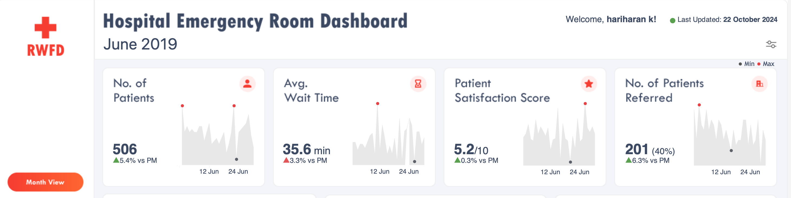
Data Visualization
Home
About us
Startegy
Contact
Sheets
Page 08

Slide 9
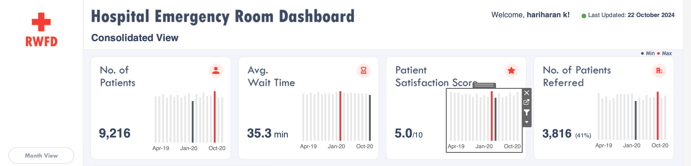
Data Visualization
Home
About us
Startegy
Contact
Sheets
Page 09

Slide 10
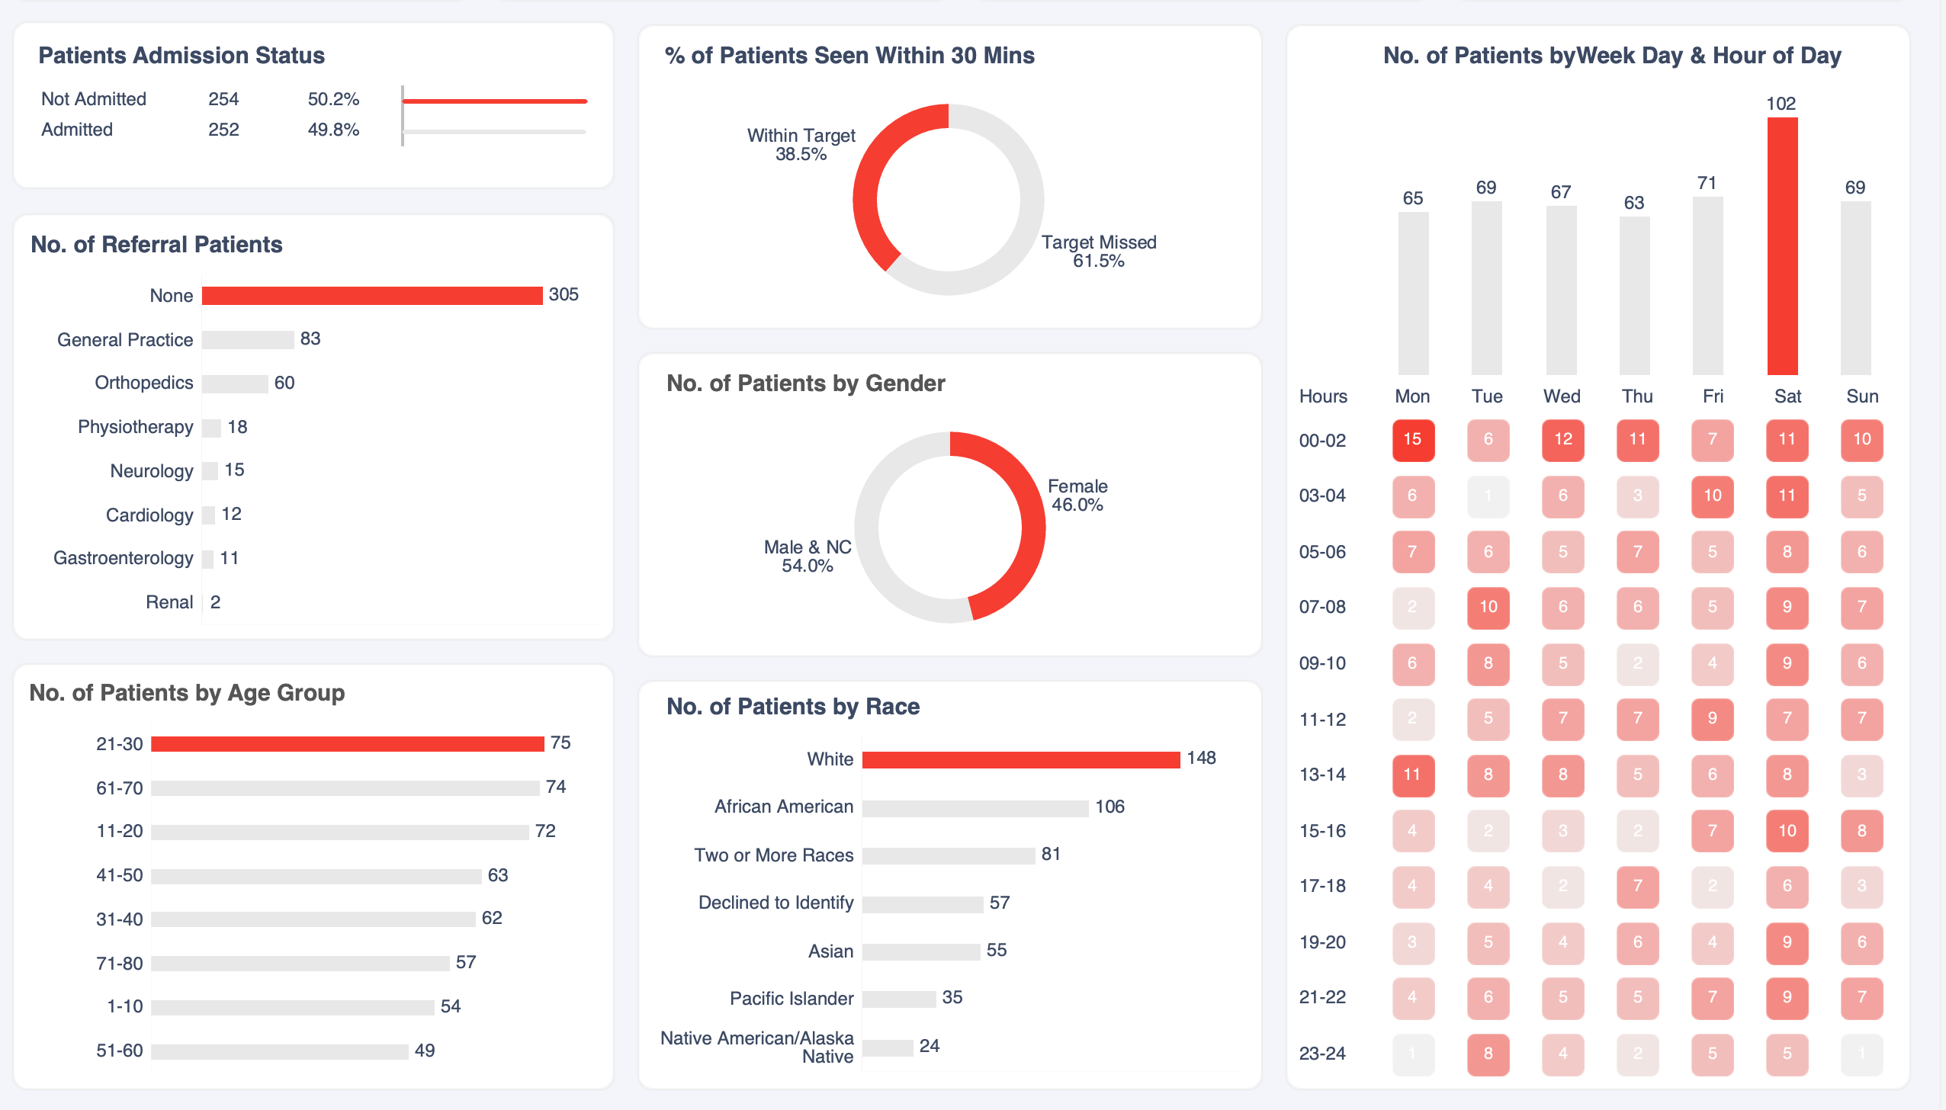
Data Visualization
Home
About us
Startegy
Contact
Sheets
Page 10

Slide 11
Data Visualization
Home
About us
Startegy
Contact
Thank
You.
Thank
You.
Thank
You.
Page 11

